Slide 1
Brownian gyrator : A Minimal heat engine on the nanoscale
R. Filliger and P. Reimann, PRL 99, 230602 (2007)

Slide 2
Introduction and summary
The original setup of heat engine consists of two heat baths in contact with a cyclically working engine, generating work in the form of a torque.
Smallest and most primitive such engine :
a single particle, gyrating around a generic potential energy minimum under the influence of friction and thermal noise forces from two heat bath

Slide 3
Introduction and summary
The particle generates a systematic average torque onto the physical object at the origin of the potential
and an opposite torque of the same magnitude by way of the dissipation mechanism onto one or both heat baths.

Slide 4
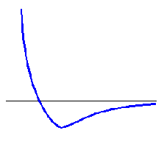
Model
generic potential energy minimum
1D
0
0

Slide 5
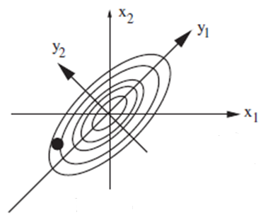
Model
generic potential energy minimum
2D

Slide 6
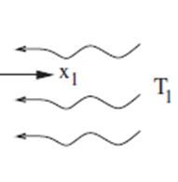
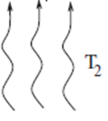
Model
& The second heat bath
The first heat bath
The first heat bath along a preferential direction without loss of generality
The second heat bath may either be of isotropic character of acting only on x2
We focus on the latter case

Slide 7
Model
Langevin equation
: mass
Potential
force
Thermal bath
effects
: temperature
: friction coefficient
: potential
: δ-correlated Gaussian white noise

Slide 8
Model
1. Neglect inertia effect
2. Consider decoupled heat baths with different T
Overdamped Langevin equations
dissipation
fluctuation
potential

Slide 9
Solution
Three relevant forces
Dissipation :
Potential force :
Fluctuation force :
Force balance :

Slide 10
Solution
Average force
Average systematic torque
Since ,

Slide 11
Solution
The torque
?
: probability density to find the particle at position x at time t

Slide 12
Calculation for eq. (4)
Overdamped Langevin equations

Slide 13
Calculation for eq. (4)
Fokker-Planck equation

Slide 14
Solution
Fokker-Planck equation
Probability current density

Slide 15
Calculation for P(x,t )
Steady state probability density

Slide 16
Calculation for P(x,t )
Diagonalize
Orthonormal matrix

Slide 17
Calculation for P(x,t )

Slide 18
Solution
torque

Slide 19
Discussion
Average torque of a BG in the steady state
For
System will be in the equilibrium state
For
Rotationally symmetric
For
symmetric

Slide 20
Discussion
Simple case (equal coupling strengths)
Maximal torque (at )
Speaking about efficiencies is no possible as long as one does not know the resulting rotation speed of the thermal baths relative to the carrier of the potential U.

Slide 21
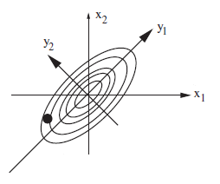
Discussion
The direction of rotation of the Brownian particle
If , ,
It is plausible that qualitatively an analogous behavior is expected also for finite T2 though the details will be more complicated

Slide 22
Experimental realizations
Block body radiation
vacuum
Charged particle
The dissipation mechanism is provided by radiation damping into the vacuum
Black body
radiation

Slide 23
Experimental realizations
Electrical heat baths
magnetic baths
Helmholtz
coil
plate
Charged particle
Paramagnetic particle
Random
Voltage
fluctuation
resistor

Slide 24
Experimental realizations
Usual heat bath and unusual heat bath
identification
Usual fluid environment of the Brownian particle
Anisotropic
Thermal fluctuations

Slide 25
Outlook
The same behavior is expected when working in 3 dimensions
It is worthy Abandoning anisotropy condition of the heat baths
Role of anisotropy condition of the heat baths
1. technical character
2. symmetry breaking
It is possible to consider the potential up to cubic order
An interesting extension of the present work will be to explore the collective phenomena due to many interacting Brownian gyrators

